Slide 1
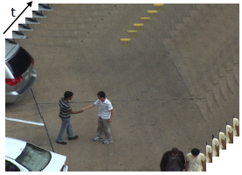
Human Action
Recognition
Avner Atias
December 2011
1

Slide 2


Problem Description and Applications
Recognition and classification of human action in image sequences (Video).
Using the temporality of video images to associate sets of images to an action
Applications:
  Real-time surveillance.
  Specific action recognition
  Message and commands
  Many more…
1

Slide 3


2 Main Approaches
Top down –
  Detect the human body
  extract geometrical features.
Bottom-up –
  Extract low level features
  classify into an action category
1

Slide 4
Solution Approaches
Three Main approaches will discussed:
  Hidden Markov Models (HMM’s)
    Junji Yamato, Jun Ohya and Kenichiro Ishii,”Recognizing human
    action in time-sequential images using HMM’s”, 1992.
  Shape motion prototype trees
    Zhe Lin, Zhuolin Jiang and Larry S. Davis, “Recognizing actions by
    shape-motion prototype trees”,
  Spatiotemporal graphs
    William Brendel and Sinisia Todorovic, “Learning spatiotemporal
    graphs of human activities”,
1

Slide 5
First Approach
    Recognizing human
    action in time-sequential images using HMM’s
    Junji Yamato
    Jun Ohya
    Kenichiro Ishii
    1992
1

Slide 6
First Approach – General Principles
Utilizes HMM’s to classify a set of images to a human action.
Bottom-up approach
Learning - HMM’s are trained for each action (category).
Recognition - The forward variable .
Action primitives.
1

Slide 7
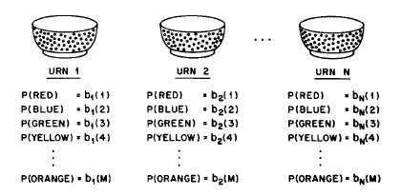
?First Approach – What Are HMM’s
Exemplary problem:
The “Hidden” part of HMM.
Taken from Rabiner’s tutorial of HMM (Link in references)
1

Slide 8
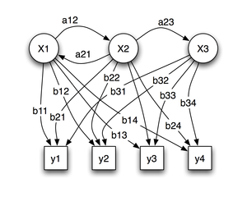
First Approach – What Are HMM’s (Cont.)
Model notations:
  A – transition matrix between states
  B – symbol output probability
  - The initial state probability.
  The set of observations.
These notation define a complete HMM:
http://en.wikipedia.org/wiki/Hidden_Markov_model
1

Slide 9
(Cont.)?First Approach – What Are HMM’s
HMM enables us to answer one of the following three questions:
  Given the observation sequence O and the model
  ,how can we efficiently compute ?
  Choose the most likely state sequence? (Viterbi algorithm)
  Maximize the probability ?
1

Slide 10

First Approach – Forward Variable
In our case we have several HMM’s.
Determine which of them is the most probable one.
The forward variable is calculated as follows:
1

Slide 11
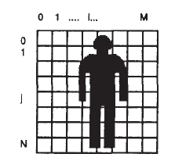
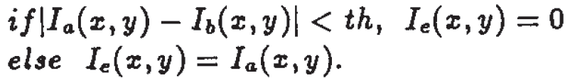
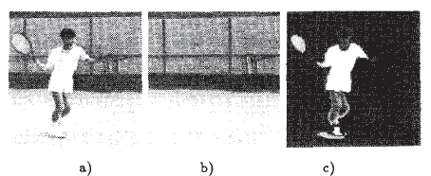

First Approach – Mesh Features
Extracting low level features of the human figure.
Mesh feature
The feature vector:
  Binarization of the image:
1

Slide 12

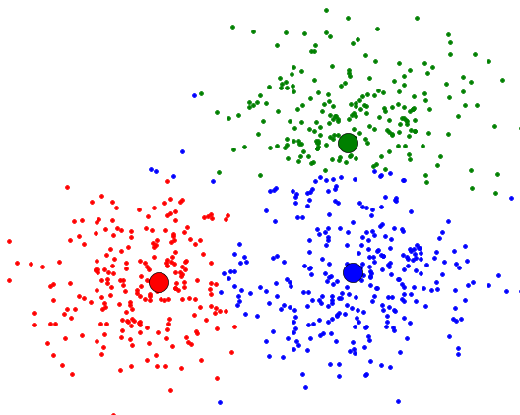
First Approach – Mesh Features (Cont.)
  Calculating the feature vector:
    Where
Clustering to 72 primitives (12 for each of 6 categories).
1

Slide 13
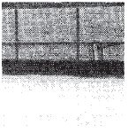
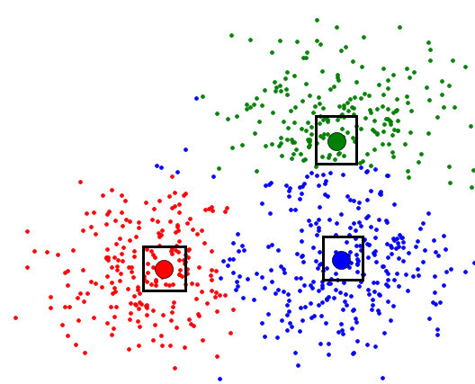
First Approach – Learning Phase
Three learning/pre-processing were applied:
  Background – Background image was saved.
  Training of the HMM’s – Baum-Welch algorithm for maximizing the category probability
  Clusters generation – code words.
1

Slide 14
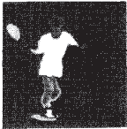
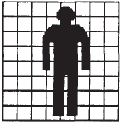
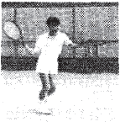
First Approach – Algorithm Block Diagram
THR
Image(t)
Human
Figure
Extraction
Mesh
Feature
Extraction
+
Background
Image
VQ
Codewords (Clusters)
Symbol
Sequence
HMM
1

Slide 15
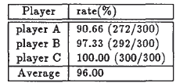

First Approach – Results
First experiment – Same persons. 10 repetitions.
Second experiment – Different persons. 10 repetitions.
1

Slide 16
First Approach – Pro’s and Con’s
Pro’s:
  Simplicity - Bottom-up approach requires low-level features of the image that are easy to extract.
Con’s:
  Threshold setting – The threshold for human figure.
  Static camera.
  Robustness
1

Slide 17
Second Approach
    Recognizing Actions by
    Shape-Motion Prototype
    Trees
    Zhe Lin
    Zhuolin Jiang
    Larry S. Davis
    ICCV 2009
1

Slide 18
Second Approach – General Principles
Full actions to atomic prototypes.
Top-down approach.
Tree configuration of the prototypes.
Shape-motion descriptors.
1

Slide 19
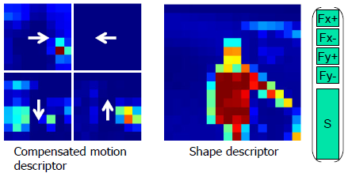
Second Approach – What Are Shape-Motion Features?
Descriptors:
The shape descriptor:
  Si = # of background pixels in region i
Motion
Shape
1

Slide 20
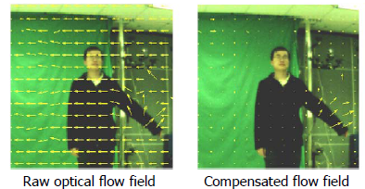
Second Approach – What Are Shape-Motion Features?
The motion descriptor is obtained as follows:
  Optical flow field ( and components).
  Median subtraction.
  Gaussian blurring.
1

Slide 21
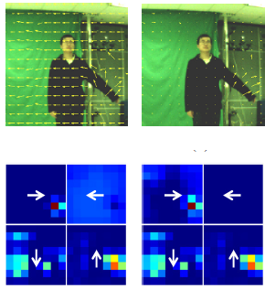
Second Approach – What Are Shape-Motion Features?
  Motion descriptor:
1

Slide 22

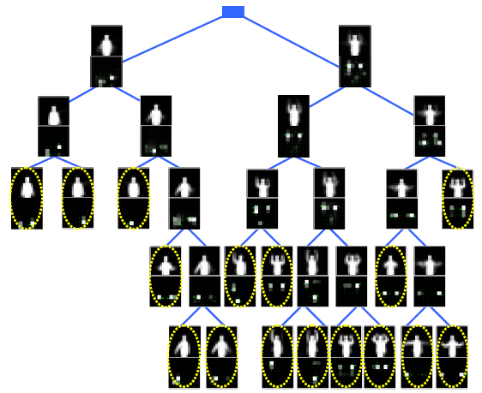
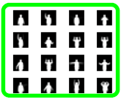

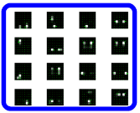
Second Approach – What Are Prototype Trees?
Action prototypes generated by K-mean clustering.
The actions (A set of prototypes) are set on a binary tree for quick search and classification.
1

Slide 23
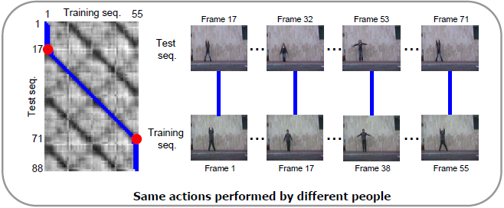
Second Approach – Learning Phase (Cont.)
Distance matrices are constructed between prototypes.
1

Slide 24
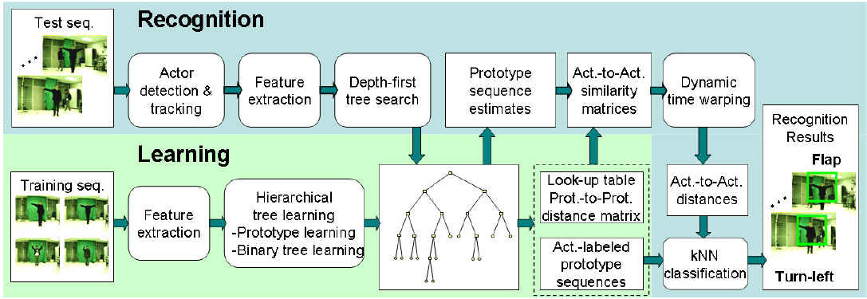
Second Approach – Algorithm Block Diagram
1

Slide 25
Second Approach – Results
Three sets of datasets were used: authors original, Weizmann and KTH.
All databases were tested using the Leave-One-Person-Out approach.
Performance:
  The joint feature method outperformed the motion or shape only methods.
  The descriptor distance method yielded the same recognition rates as the joint method.
1

Slide 26

Second Approach – Experiments
Authors Original Dataset
General description:
  14 different gesture classes
  3 persons
  Each gesture class was performed 3 times
  Size: 3x3x14 = 126 learning videos sequences
Experiments:
  Changing descriptors (Static camera):
1

Slide 27
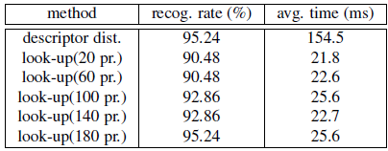
Second Approach – Experiments (Cont.)
Authors Original
  Changing the number of prototypes (Static camera):
1

Slide 28

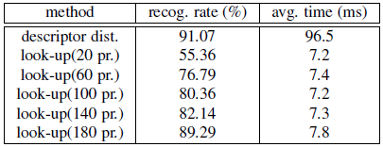
Second Approach – Results (Cont.)
Authors Original
  Changing descriptors (Dynamic camera and background):
  Changing the number of prototypes (Dynamic camera and background):
1

Slide 29

Second Approach – Results (Cont.)
Weizmann Dataset
General description:
  10 prototype classes
  9 persons
Experiments:
  Static or dynamic? (Not stated)
  Changing descriptors:
1

Slide 30
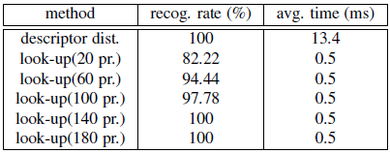
Second Approach – Results (Cont.)
Weizmann Dataset
  Changing the number of prototypes
1

Slide 31
Second Approach – Pro’s and Con’s
Pro’s:
  The joint approach of motion and shape descriptors increases robustness
  Static and dynamic cameras.
Con’s:
  The detection of the human figure is computationally expansive (Optical flow)
1

Slide 32
Third Approach
    Learning spatiotemporal
    Graphs of
    Human actions
    William Braendel
    Sinisa Todorovic
    ICCV 2011
1

Slide 33
Third Approach – General Principles
Uses motion and intensity features to generate motion 2D+t tubes.
Learns actions’ graphs and matches new actions to those graphs for classification.
Top-down approach.
1

Slide 34
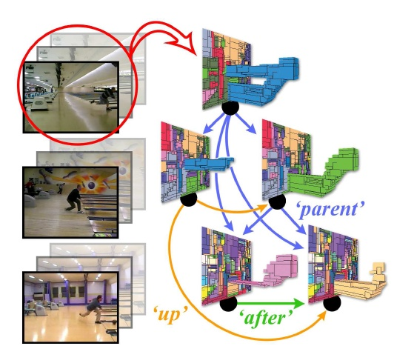
Third Approach – What are the 2D+t tubes?
Objects’ and their motion are extracted throughout the image sequence.
These tubes represent
the objects relevant 3D
spatiotemporal motion.
1

Slide 35
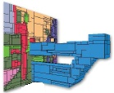
Third Approach – What are the 2D+t tubes?
The tubes constructed by homogeneous blocks.
Homogeneous block: a group of pixels that present a lower variation in motion and intensity then its surrounding
1

Slide 36
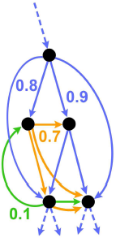
Third Approach – Extracting the graphs
After a video was segmented to relevant moving objects, and the tubes were extracted, a spatiotemporal graph is rendered.
Object
Segmentation
Spatiotemporal
Graph
Generation
Tubes
Extraction
1

Slide 37
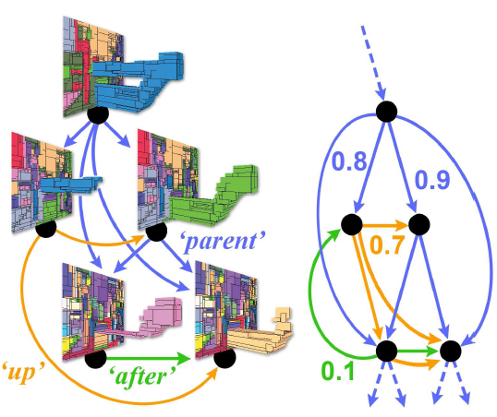
Third Approach – Extracting the graphs (Cont.)
Graph nodes represent the tubes.
Edges: 3 types of relationships between the tubes:
  Hierarchical (‘ascendant’, ‘descendant’)
  Temporal (‘before’, ‘after’, ‘overlap’, ‘meet’).
  Spatial (‘Left’, ‘Up', 'Down’, ‘Right’).
The directed edges are labeled with
the strength of the relationships
1

Slide 38
Third Approach – Extracting the graphs (Cont.)
Adjacency matrices were computed (nxn, where n – the number of nodes)
The matrices contains the strength of each of the 3 relationships, between all nodes.
The strengths were computed as follows:
  Hierarchical – the ratio of ascendant-descendant volume.
  Temporal – The ratio between the number of frames of the tube and the while video.
  Spatial – Binary values for absent or present (within a certain distance from each tube).
1

Slide 39
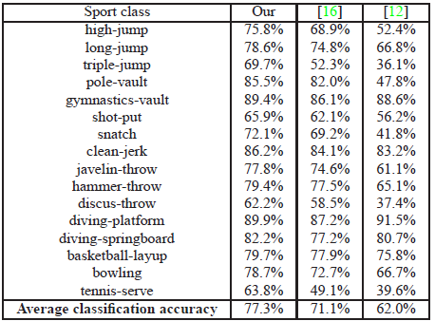
Third Approach – Results
The database used was the Olympic sports dataset.
The results were compared to other existing methods, both in accuracy of recognition and running-time.
[12] I. Laptev,M.Marszalek, C. Schmid, B. Rozenfeld, I. Rennes,
I. I. Grenoble, and L. L. B. Learning realistic human actions
from movies. In CVPR, 2008. 7
[16] J. C. Niebles, C.-W. Chen, , and L. Fei-Fei. Modeling temporal
structure of decomposable motion segments for activity
classification. In ECCV, 2010. 1, 6, 7, 8
1

Slide 40

Third Approach – Results (Cont.)
Accuracy results were usually better than other methods:
[20] S. Todorovic and N. Ahuja. Unsupervised category modeling,
recognition, and segmentation in images. IEEE TPAMI,
30(12):1–17, 2008.
1

Slide 41
Third Approach – Pro’s and Con’s
Pro’s:
  After graphs were extracted, the matching problem reduces to QAP (Quadratic Assignment Problem).
  More aware about what parts of the image represent the actions and movements relevant to the overall action.
Con’s:
  The article is not self contained – the QAP is solved using the commercial cvx software.
1

Slide 42
Conclusion and Timeline
The three methods presented represent a timeline of improvements:
Approach | Year | Feature | Model | Learning
Hidden Markov Models (HMM’s) | 1992 | Mesh feature | HMM | +
Shape motion prototype trees | 2009 | shape-motion | Binary tree | +
Spatiotemporal graphs | 2011 | shape-motion | Directed graph | +
1

Slide 43
Conclusion and Timeline (Cont.)
Performance comparison:
  In terms of run time, only the last 2 approaches can be compared because of almost 20 years of hardware difference:
  Accuracy:
Approach | Running Time [m/s]
Shape motion prototype trees | 0.5
Spatiotemporal graphs | 14.2
Approach | Average Recognition %
Shape motion prototype trees | 94.22
Spatiotemporal graphs | 77.30
1

Slide 44
Conclusion and Timeline (Cont.)
Note: The accuracy comparison is limited because the datasets differ, and only the last 2 approaches handled dynamic camera and background issues.
1

